Slide 1

UNIT 7: RECIPES & EATING HABITS
Period 56-Lesson 2: A Closer look 1

Slide 2
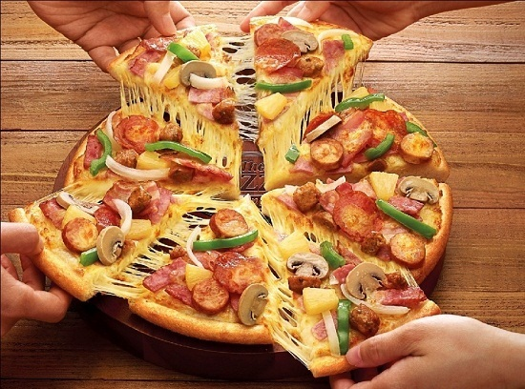
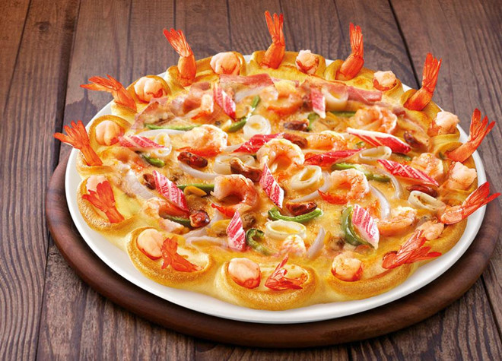
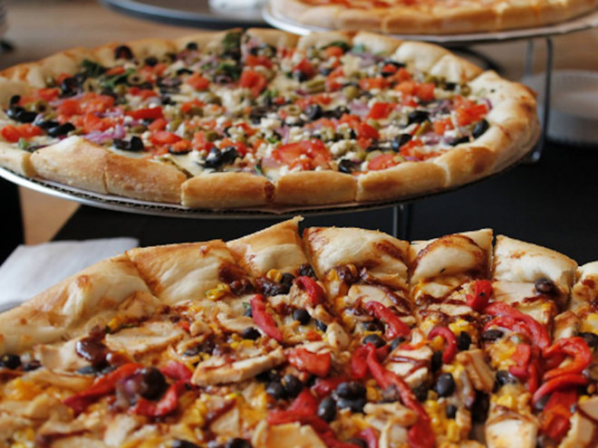
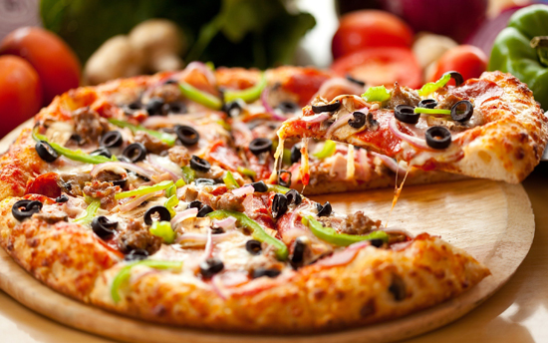

Slide 3
I. Vocabulary
- whisk: (v) đánh (trứng, kem…) /wisk/
- slice: (v) thái lát
- grate: (v) nạo, mài /greit/
- dip: (v) nhúng, ngâm
- chop: (v) chặt, cắt
- spread: (v) phết, trải ra
- sprinkle: (v) rắc /'spriɳkl/
- Marinate (v) ướp /ˈmerəˌnāt/
- stir – fry (v) xào
- deep – fry (v) chiên
- grill (v) nướng
- bake (v) nung
- steam (v) hấp
- simmer (v) ninh /'simə/

Slide 4
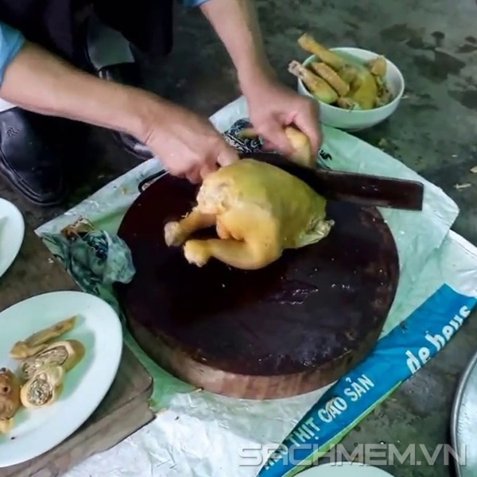
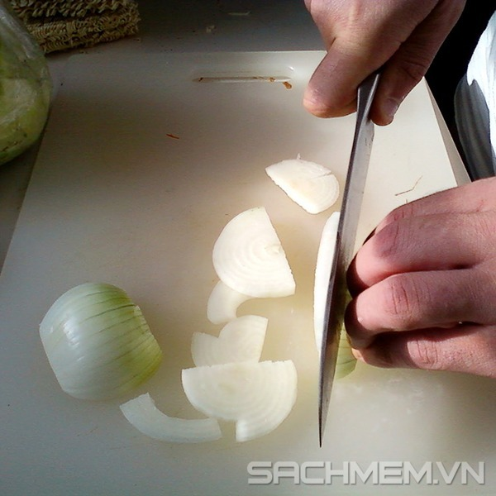
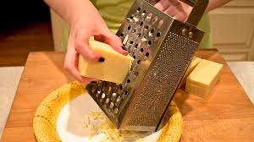
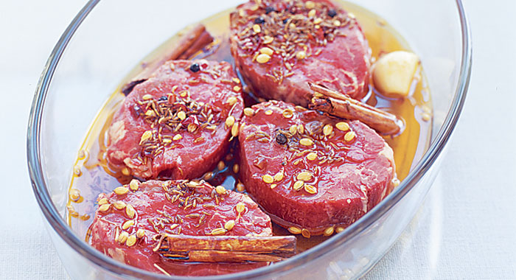
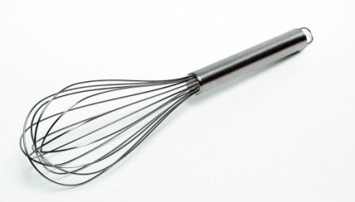
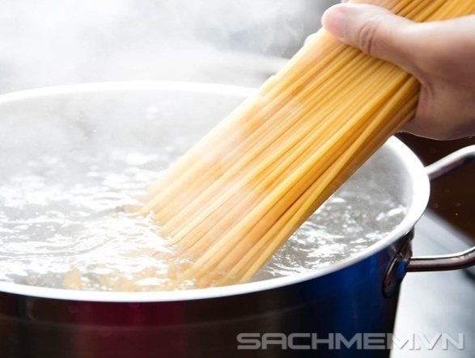

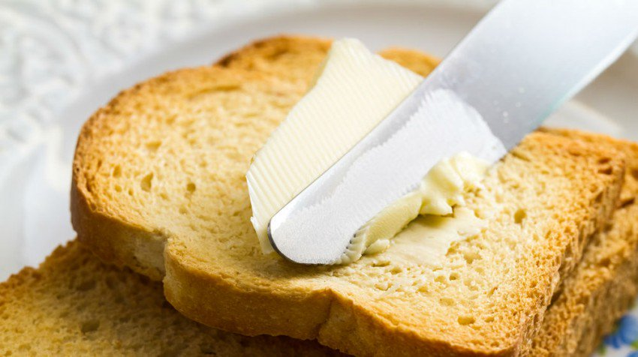
1. Write a food preparation verb from the box under each picture.
chop
slice
spread
dip
grate
whisk
sprinkle
marinate
whisk
A………………
B………………
C………………
D……………
E………………..
F………………
G………………
H…………….

Slide 5
2. Complete the sentences with the correct form of the verbs in 1 .
1. Don’t ____the cucumber into chunks. ___ thinly.
2. My mother usually ______ some cheese and _________ it over the pasta.
3. ______ the chicken in white wine for one hour
before roasting.
4. To make this cake successfully, you should ______
the eggs lightly.
5. ______ the prawns into the batter.
6. Can you ______ the butter on this slice of bread
for me?
chop
Slice
grates
sprinkles
Marinate
whisk
Dip
spread

Slide 6
3. Match each cooking verb in A with its definition in B.
A | B
1. stir-fry | a. place food over boiling water so that it cooks in the steam.
2. deep-fry | b. cook something be keeping it almost at boiling point.
3. roast | c. cook food under or over a very strong heat.
4. grill | d. cook something slowly in liquid in a closed dish.
5. bake | e. cook cakes or bread in an oven.
6. steam | f. fry food in oil that covers it completely.
7. stew | g. cook thin strips of vegetables or meat quickly by stirring them in very hot oil
8. simmer | h. cook meat, or vegetables without liquid in an oven or over a fire.
1-g
2-f
3-h
4-c
5-e
6-a
7-d
8-b

Slide 7
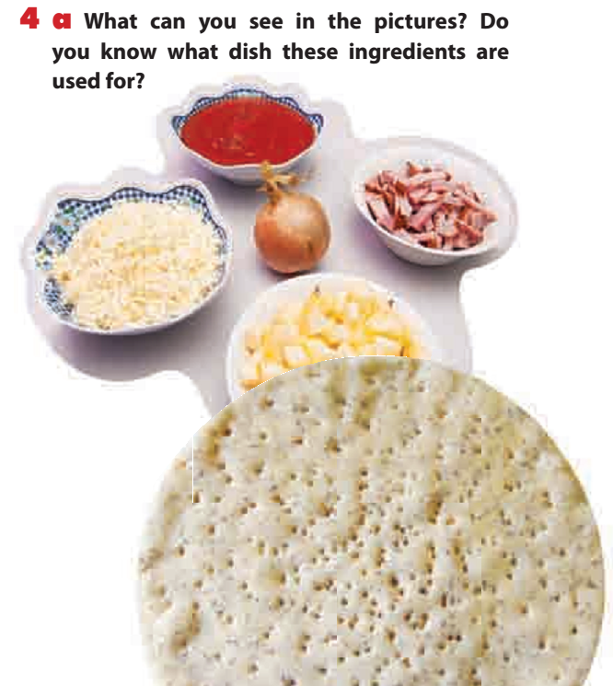
tomato sauce
bacon
onion
cheese
apple
Pizza
pizza base

Slide 8
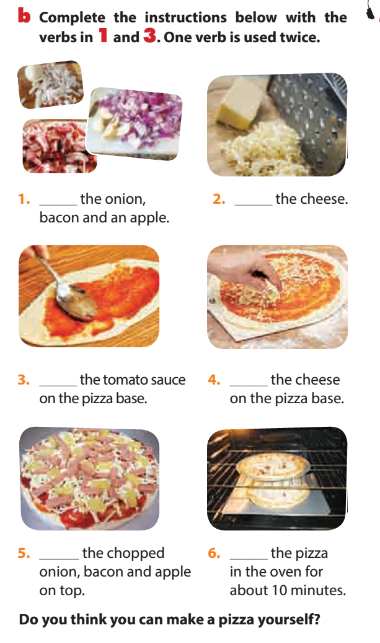
Do you think you can make a pizza yourself?
Chop
Grate
Spread
Sprinkle
Spread
Bake

Slide 9

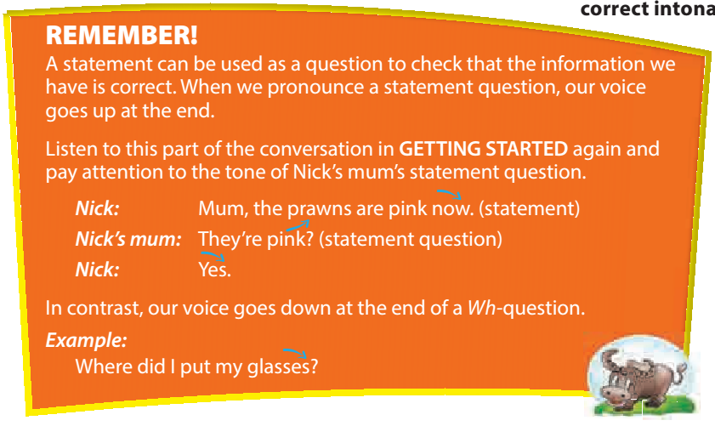


Slide 10
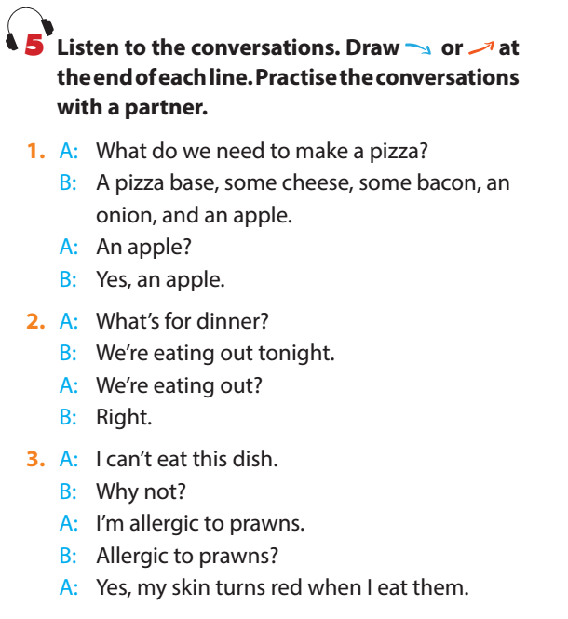
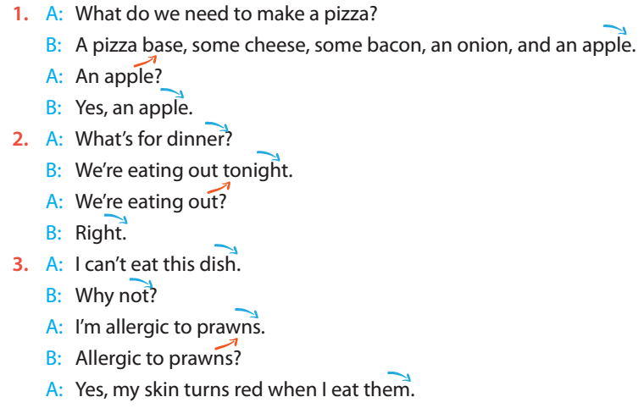

Slide 11
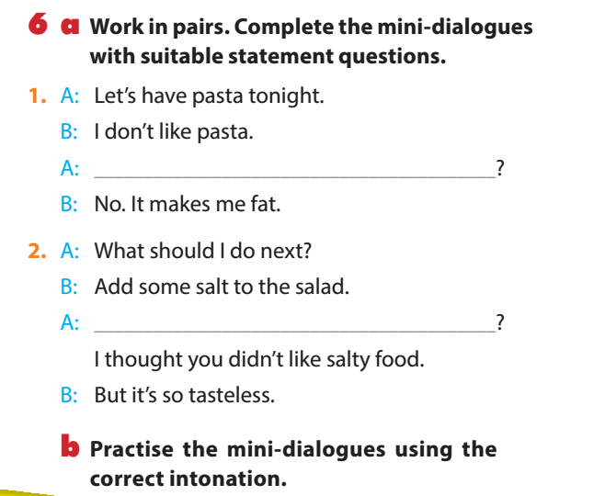
You don’t like pasta?
Don’t like pasta?
Add some salt?

Slide 12


HOMEWORK
- Learn by heart new words.
- Do all the exercises again
- Prepare Unit 7 : A closer look 2

